Slide 1

DIGITAL ELECTRONICS
IV Semester ECE
Dr. Ranjita Rout
DEPARTMENT OF ELECTRONICS AND COMMUNICATION ENGINEERING
SCHOOL OF ENGINEERING & TECHNOLOGY
GIET UNIVERSITY, GUNUPUR, ODISHA

Slide 2
Analysis of Clocked Sequential Circuits; Mealy and Moore Models of Finite State Machines;
Design Procedure

Slide 3
Analysis of Clocked Sequential Circuits
Analysis describes what a given circuit will do under certain operating conditions.
The behavior of a clocked sequential circuit is determined from the inputs, the outputs, and the state of its flip-flops.
The outputs and the next state are both a function of the inputs and the present state.
The analysis of a sequential circuit consists of obtaining a table or a diagram for the time sequence of inputs, outputs, and internal states.
It is also possible to write Boolean expressions that describe the behavior of the sequential circuit.

Slide 4
For analysis of clocked sequential circuits, the steps are described below:
  Circuit diagram
  State equations
  State table
  State diagram

Slide 5
The next-state values can also be obtained by evaluating the state equations from the characteristic equation. This is done by using the following procedure:
  Determine the flip-flop input equations in terms of the present state and input variables.
  Substitute the input equations into the flip-flop characteristic equation to obtain the state equations.
  Use the corresponding state equations to determine the next-state values in the state table.

Slide 6
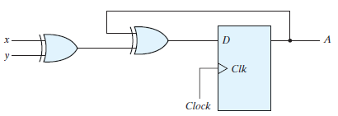
Example: Derive the state table and the state diagram of the sequential circuit shown in Fig.
It has one D flip-flop A, and two input x and y.
The input equation D_{A} = A Ꚛ x Ꚛ y
The characteristic equation of a D flip-flop
Q(t + 1) = D
The next-state values are obtained from the state equation A(t + 1) = D_{A} = A Ꚛ x Ꚛ y

Slide 7
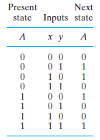

State table
State diagram

Slide 8
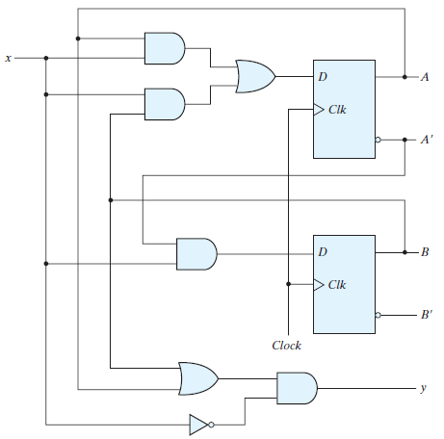
Example: Derive the state table and the state diagram of the sequential circuit shown in Fig.

Slide 9
It consists of two D flip-flops A and B, an input x and an output y.
The circuit can be specified by the flip-flop input equations:
D_{A} = Ax + Bx D_{B} = A’x
The out equation: y = (A + B)x’
The characteristic equation of a D flip-flop
Q(t + 1) = D
The next-state values are obtained from the state equation
A(t + 1) = D_{A} = Ax + Bx
B(t + 1) = D_{B} = A’x

Slide 10
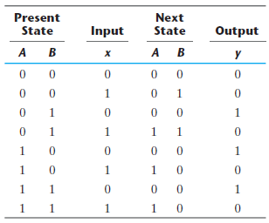
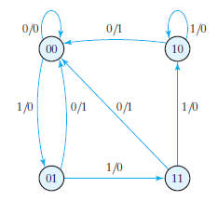
State table
State diagram

Slide 11
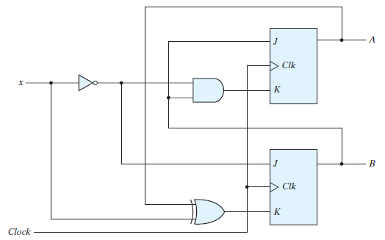
Example: Derive the state table and the state diagram of the sequential circuit shown in Fig.

Slide 12
It has two JK flip-flops A and B and one input x.
The circuit can be specified by the flip-flop input equations
J_{A} = B K_{A} = Bx’
J_{B} = x K_{B} = A Ꚛ x
The characteristic equation of a JK flip-flop
Q(t + 1) = JQ’ + K’Q

Slide 13
The characteristic equations for the flip-flops are obtained by substituting A or B for the name of the flip-flop, instead of Q:
A(t + 1) = J_{A}A’ + K_{A}’A
B(t + 1) = J_{B}B’ + K_{B}’B
Substituting the values of J_{A} and K_{A} from the input equations, we obtain the state equation for A:
A(t + 1) = BA’ + (Bx’)’A = A’B + AB’ + Ax
Similarly, the state equation for flip-flop B can be derived from the characteristic equation by substituting the values of J_{B} and K_{B}:
B(t + 1) = x’B’ + (A Ꚛ x)’B = B’x’ + ABx + A’Bx’

Slide 14
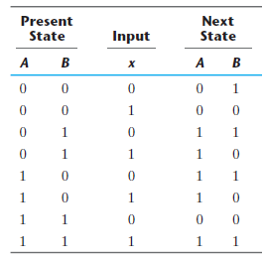
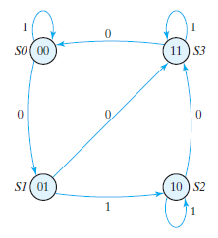
State table
State diagram

Slide 15
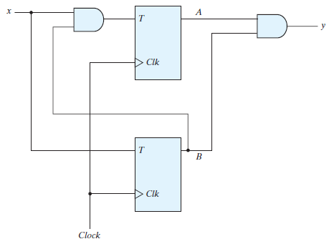
Example: Derive the state table and the state diagram of the sequential circuit shown in Fig.

Slide 16
It has two T flip-flops A and B, one input x, and one output y and can be described algebraically by two input equations and an output equation:
T_{A} = Bx T_{B} = x
y = AB
The characteristic equation of T flip-flop
Q(t + 1) = T Ꚛ Q = T’Q + TQ’
The values for the next state can be derived from the state equations by substituting T_{A} and T_{B} in the characteristic equations, yielding
A(t + 1) = T_{A}’A + T_{A}A’ = (Bx)’A + (Bx)A’ = AB’ + Ax’ + A’Bx
B(t + 1) = T_{B}’B + T_{B}B’ = x’B + xB’ = x Ꚛ B

Slide 17
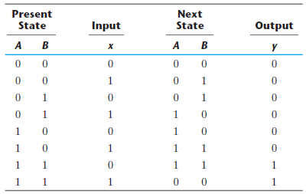
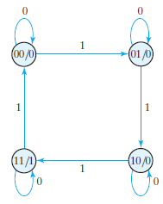
State table
State diagram

Slide 18
Mealy and Moore Models of Finite State Machines
The most general model of a sequential circuit has inputs, outputs, and internal states.
It is customary to distinguish between two models of sequential circuits: the Mealy model and the Moore model.
They differ only in the way the output is generated.
In the Mealy model, the output is a function of both the present state and the input.
In the Moore model, the output is a function of only the present state.

Slide 19
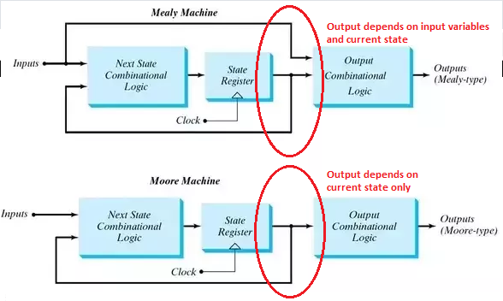
Block diagrams of Mealy and Moore state machines

Slide 20
A circuit may have both types of outputs.
The two models of a sequential circuit are commonly referred to as a finite state machine, abbreviated FSM.
  The Mealy model of a sequential circuit is referred to as a Mealy FSM or Mealy machine.
  The Moore model is referred to as a Moore FSM or Moore machine.

Slide 21

In Mealy model state diagram, both the input and output values separated by a slash along the directed lines between the states.
In Moore model state diagram, the input value in the state diagram is labeled along the directed line, but the output value is indicated inside the circle together with the present state.

Slide 22
In a Moore model, the outputs of the sequential circuit are synchronized with the clock, because they depend only on flip-flop outputs that are synchronized with the clock.
In a Mealy model, the outputs may change if the inputs change during the clock cycle. Thus, the output of the Mealy machine is the value that is present immediately before the active edge of the clock.

Slide 23
Design Procedure
Design procedures or methodologies specify hardware that will implement a desired behaviour.
The design of a clocked sequential circuit starts from a set of specifications and culminates in a logic diagram or a list of Boolean functions from which the logic diagram can be obtained.
A synchronous sequential circuit is made up of flip-flops and combinational gates.

Slide 24
The procedure for designing synchronous sequential circuits can be summarized by a list of recommended steps:
  From the word description and specifications of the desired operation, derive a state diagram for the circuit.
  Reduce the number of states if necessary.
  Assign binary values to the states.
  Obtain the binary-coded state table.
  Choose the type of flip-flops to be used.
  Derive the simplified flip-flop input equations and output equations.
  Draw the logic diagram.

Slide 25
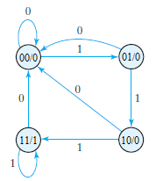
Example: Design the sequential circuit specified by the state diagram of Fig., using D flip-flops.

Slide 26
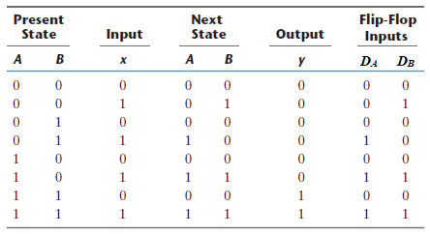
We choose two D flip-flops to represent the four states, and we label their outputs A and B. There is one input x and one output y.
State Table

Slide 27
The flip-flop input equations D_{A} and D_{B} can be obtained from the columns flip-flop inputs in the state table and expressed in sum-of-minterms form as
D_{A}(A, B, x) = ∑(3, 5, 7)
D_{B}(A, B, x) = ∑(1, 5, 7)
y(A, B, x) = ∑(6, 7)
where A and B are the present-state values of flip-flops A and B, and x is the input. The minterms for output y are obtained from the output column in the state table.

Slide 28
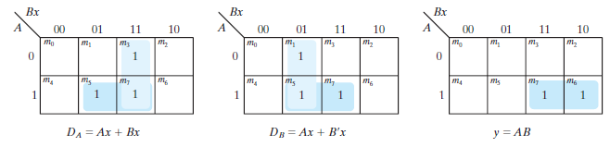
Maps for D input and output y equations
The simplified equations are
D_{A} = Ax + Bx
D_{B} = Ax + B’x
y = AB

Slide 29
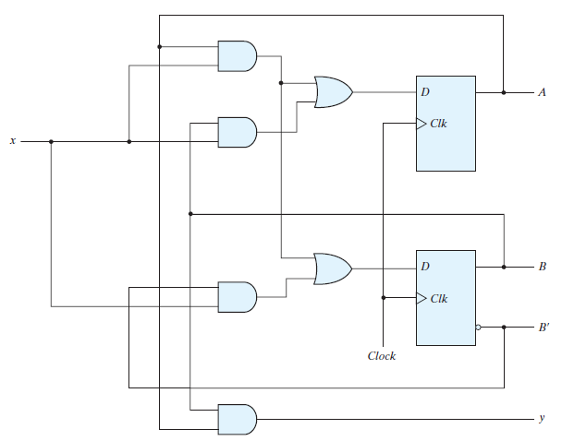
Logic diagram of the sequential circuit with D flip-flops

Slide 30
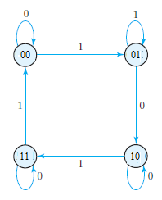
Example: Design the sequential circuit specified by the state diagram of Fig., using JK flip-flops.

Slide 31
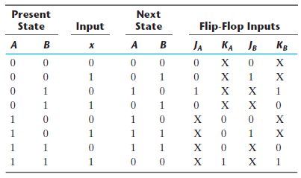
State Table and JK Flip-Flop Inputs

Slide 32
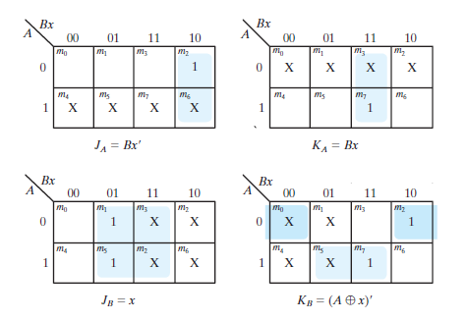
Maps for J and K input equations

Slide 33
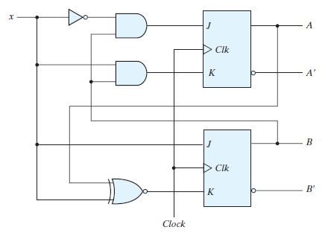
Logic diagram of the sequential circuit with JK flip-flops

